Slide 1
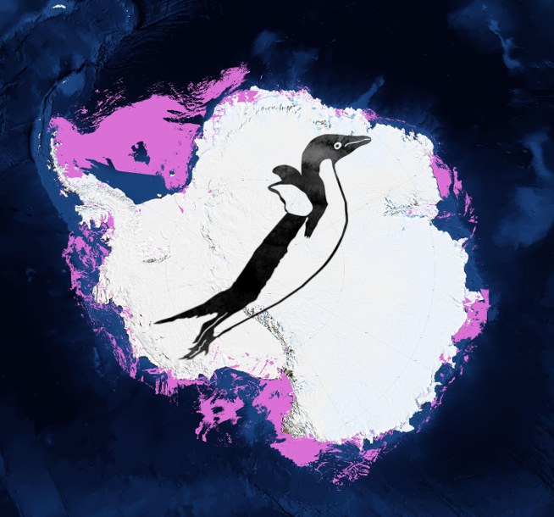
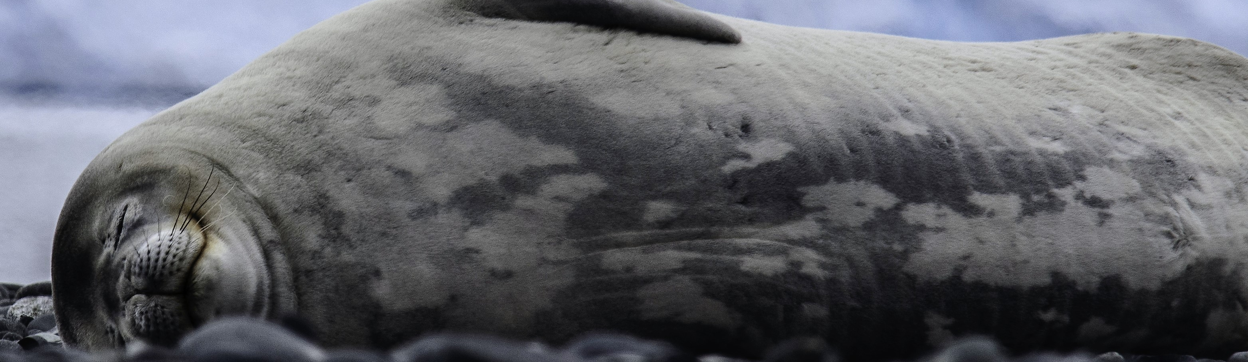
Seal Team 6
http://polar-computing.org

Slide 2
Science Objective
Identify individual Weddell seals
Construct a Weddell Seal image catalog
Understand movement of Weddell seals over time

Slide 3
Seal image catalog
Image 1
Many possible algorithms ➣ Consensus-based approach
Image 2
✓
Seal 1
Match new image to the existing catalog to look for matches
Image 3
Image 4
Algorithm 1
Algorithm 2
Algorithm 3
Consensus
✗
…
Image 1 0.05
Image 2 0.07
Image 3 0.12
.
.
.
Image 1 0.15
Image 2 0.01
Image 3 0.02
.
.
.
Image 1 0.04
Image 2 0.17
Image 3 0.10
.
.
.
Image 1 0.09
Image 2 0.23
Image 3 0.08
.
.
.
Image 10
Image 11
Seal 2
Image 12
Image 13
…

Slide 4
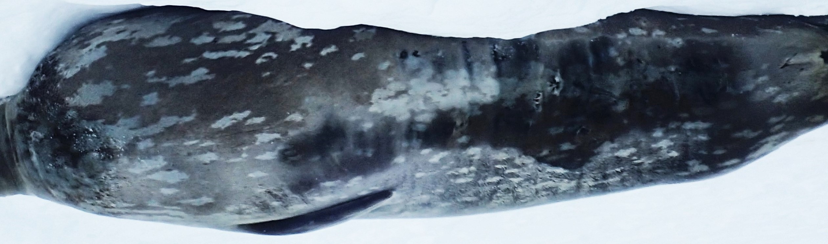
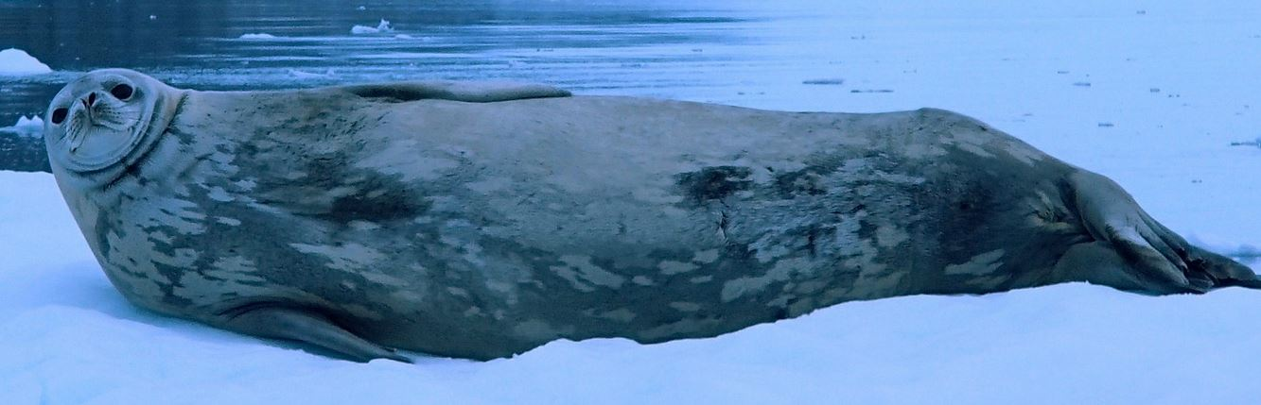
One possible algorithm…
‘Bag of patches’ model
(inspired by ‘bag-of-words’ modeling for text analysis)
Collection of patches 1
Some number of shared patches indicative of match
Collection of patches 2

Slide 5
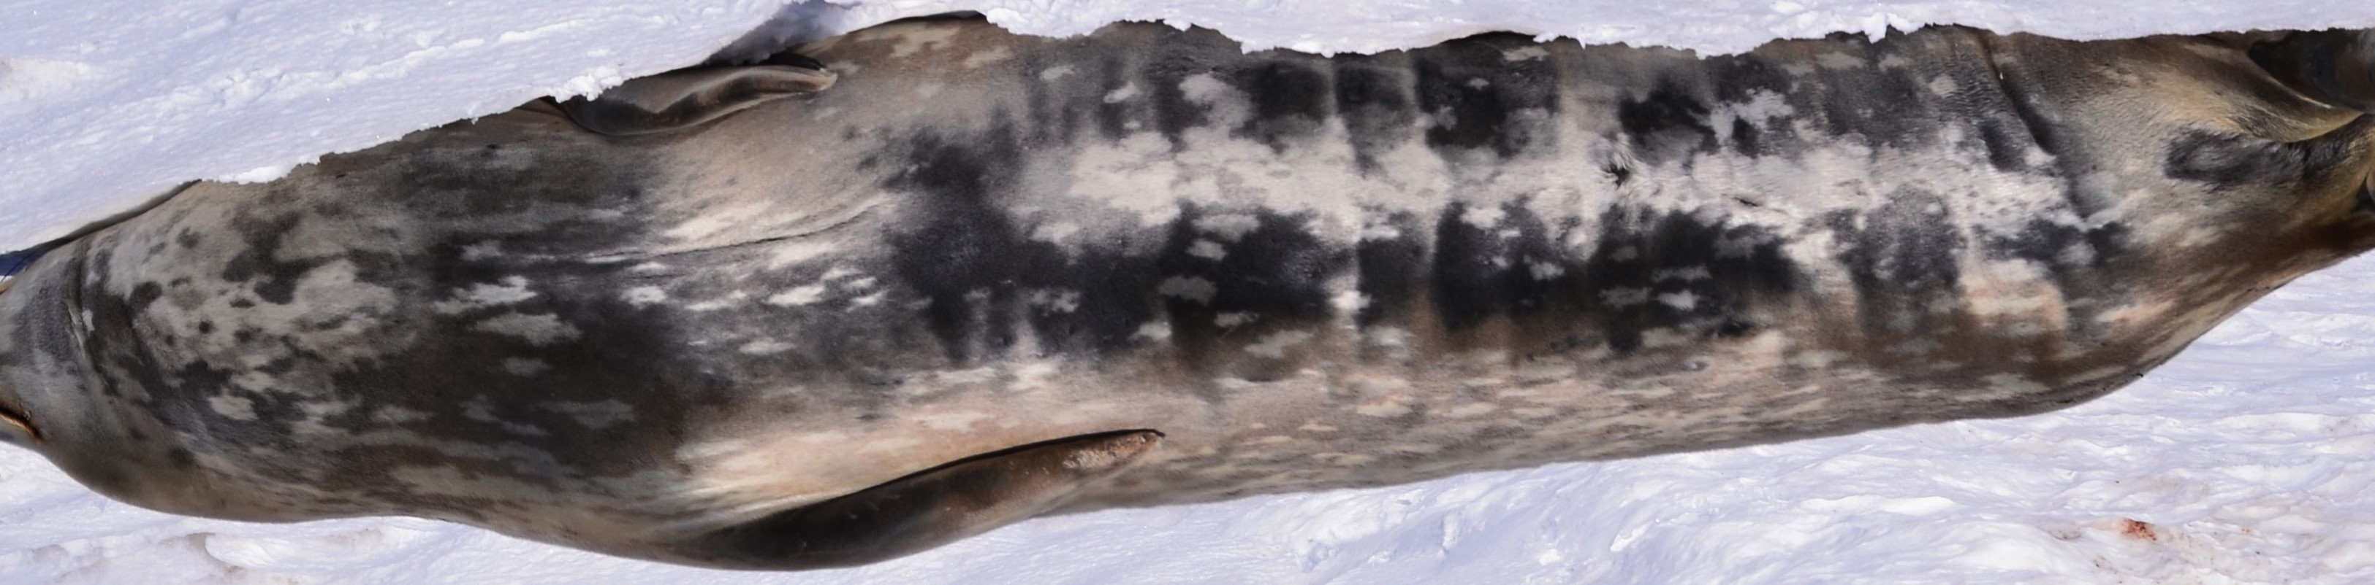
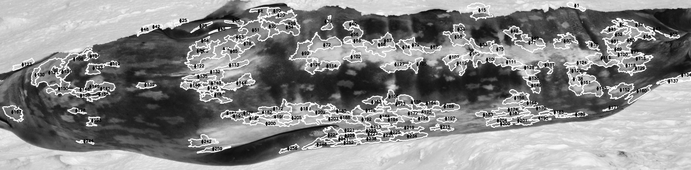
Basic workflow
Calculate maximum patch match
gamma correction
adaptive threshold
boundary
segment
and weight by patch complexity
Patch complexity metric inspired by
Grove et al. 2015

Slide 6
What did you not achieve?
Didn’t link to HPC yet, but identified areas where parallelization may speed the match process
No clear algorithm for creating a consensus given multiple algorithms

Slide 7
Any highlights? What worked? What didn’t?
No major barriers, just requires more time

Slide 8
Biggest insight/lesson learnt?
By Scientists?
Considerably more complicated than anticipated (which is probably why the existing tools for pattern matching don’t work that well for seals)
By programmers?

